Slide 1
Class and Objects
Python is Object Oriented Programming
What is Object Oriented Programming.
Object-oriented programming (OOP) is a programming language model organized around objects rather than "actions" and data rather than logic.
Why Object Oriented Programming
The OOP introduced new concepts for looking to softwares design : real world Object concept.
This concept will come to produce softwares as seperated code modules which rise up decoupling and increases code re-usability.
Data security

Slide 2
OOPS CONCEPTS
Class
Objects
Encapsulation
Inheritance
Polymorphism
Abstraction
Association

Slide 3
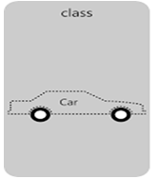
CLASS
Class is a user-defined prototype for an object that defines a set of attributes that characterize any object of the class. The attributes are data members (class variables and instance variables) and methods, accessed via dot notation.
Class variable: A variable that is shared by all instances of a class. Class variables are defined within a class but outside any of the class's methods. Class variables are not used as frequently as instance variables are.
Instance variable: A variable that is defined inside a method and belongs only to the current instance of a class.
Syntax:
class ClassName:
<statement-1>
.
.
<statement-N>
Example
class Vehicle: pass

Slide 4
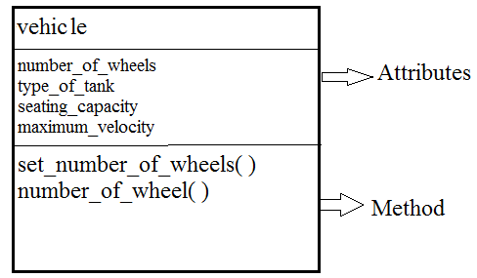
UML Diagram
Class Diagram

Slide 5
Attributes
"In computing, an attribute is a specification that defines a property of an object, element, or file. It may also refer to or set the specific value for a given instance of such."
Remember that our vehicle class has four attributes:
number of wheels, type of tank, seating capacity, and maximum velocity.
We set all these attributes when creating a vehicle object. So here, we define our class to receive data when it initiates it:
Example
class Vehicle:
self.number_of_wheels = number_of_wheels
self.type_of_tank = type_of_tank
self.seating_capacity = seating_capacity
self.maximum_velocity = maximum_velocity

Slide 6
Method
Methods in Python are essentially functions in accordance with Guido's saying "first-class everything".
All attributes are set.
But how can we access these attributes’ values?
We send a message to the object asking about them. We call it a method. It’s the object’s behavior.
Let’s implement it:
Example
def set_number_of_wheels(self, number):
self.number_of_wheels = number
def number_of_wheels(self):
return self.number_of_wheels

Slide 7
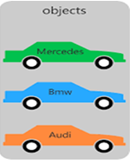
Object:
A unique instance of a data structure that's defined by its class. An object comprises both data members (class variables and instance variables) and methods.
Syntax:
ObjectName=className()
Obj=Myclass()
Example 1:
car = Vehicle()
print(car) # <__main__.Vehicle instance at 0x7fb1de6c2638>
Here car is an object (or instance) of the class Vehicle.

Slide 8
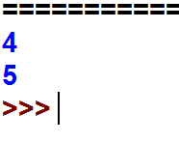
Example
class Vehicle:
number_of_wheels = 4
type_of_tank = 'electric'
seating_capacity = 5
maximum_velocity = 250
def set_number_of_wheels(self, number):
self.number_of_wheels = number
def number_of_wheel(self):
return self.number_of_wheels
v=Vehicle()
print(v.number_of_wheels)
v.set_number_of_wheels(5)
print(v.number_of_wheels)

Slide 9
Constructors in Python
Class functions that begins with double underscore (__) are called special functions as they have special meaning.
__init__ is a method which is immediately and automatically called after an instance has been created
The __init__ method is used to initialize an instance.
The __init__ method can be anywhere in a class definition, but it is usually the first method of a class, i.e. it follows right after the class header.
Example
class A
def __init__(self):
print("__init__ has been executed!") ...
x = A()
#__init__ has been executed!

Slide 10

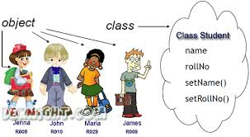
Example :
class Student:
def __init__(self, rollno, name):
self.rollno = rollno
self.name = name
def displayStudent(self):
print ("rollno : ", self.rollno, ", name: ", self.name )
s1 = Student(121, “jenna")
s2 = Student(122, “john")
s1.displayStudent()
s2.displayStudent()

Slide 11

Destructor
These methods are only called on creation and destruction of the object. They are not called manually but completely automatic.
Example
The class below has a constructor (init) and destructor (del).We create an instance from the class and delete it right after.
class Vehicle:
def __init__(self):
print('Vehicle created.')
def __del__(self):
print('Destructor called, vehicle deleted.')
car = Vehicle()
del car

Slide 12
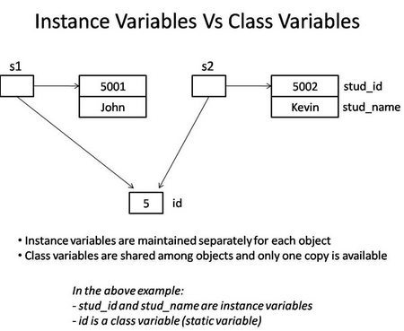
Class variable Vs Object variable.
Class variable :-
is shared and accessed by all objects of class.
When any one object makes a change to class variable,the change is reflected in all instances.
Object Variable :-
Owned by individual object/instance
Each object has its own copy
Not Shared

Slide 13
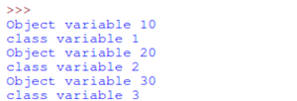
Example :
class Myclass:
cv=0
def __init__(self,var):
Myclass.cv+=1 #class variable
self.var=var #Object variable
print("Object variable",var)
print("class variable",Myclass.cv)
m1=Myclass(10)
m2=Myclass(20)
m3=Myclass(30)
print(Myclass.var)

Slide 14
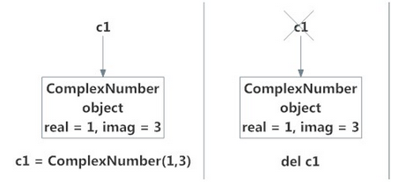

Deleting Attributes and Objects
similar to destructor.
automatically called when object is going out of scope
To delete an attributname:
Syntax: del objname.attributename
To delete an object:
Syntax : del objectname
class ComplexNumber:
def __init__(self,r = 0,i = 0):
self.real = r
self.imag = i
def getData(self):
print("{0}+{1}j".format(self.real,self.imag))
c1 = ComplexNumber(2,3)
c1 = ComplexNumber(1,3)
del c1
c1

Slide 15
Methods ….
Let’s begin by writing a class that contains simple examples for all three method types:
class MyClass:
def method(self):
return 'instance method called', self
@classmethod
def classmethod(cls):
return 'class method called', cls
@staticmethod
def staticmethod():
return 'static method called'
Instance Methods
The first method on MyClass, called method, is a regular instance method.
You can see the method takes one parameter, self, which points to an instance of MyClass when the method is called
Class Methods
Instead of accepting a self parameter, class methods take a cls parameter that points to the class—and not the object instance—when the method is called.
Static Methods
This type of method takes neither a self nor a cls parameter

Slide 16
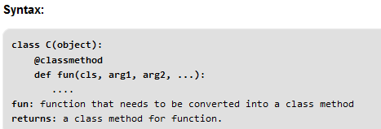
Methods ….
Class Method
A class method is a method which is bound to the class and not the object of the class.
They have the access to the state of the class as it takes a class parameter that points to the class and not the object instance.
It can modify a class state that would apply across all the instances of the class. For example it can modify a class variable that will be applicable to all the instances.

Slide 17
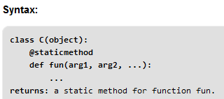
Methods ….
Static Method
A static method is also a method which is bound to the class and not the object of the class.
A static method can’t access or modify class state.
It is present in a class because it makes sense for the method to be present in class.
When to use what?
We generally use class method to create factory methods. Factory methods return class object ( similar to a constructor ) for different use cases.
We generally use static methods to create utility functions.

Slide 18

Example
from datetime import date
class Person:
def __init__(self, name, age):
self.name = name
self.age = age
@classmethod # a class method to create a Person object by birth year.
def fromBirthYear(cls, name, year):
return cls(name, date.today().year - year)
@staticmethod # a static method to check if a Person is adult or not.
def isAdult(age):
return age > 18
person1 = Person('mayank', 21)
person2 = Person.fromBirthYear('mayank', 1996)
print person1.age
print person2.age
print Person.isAdult(22)

Slide 19

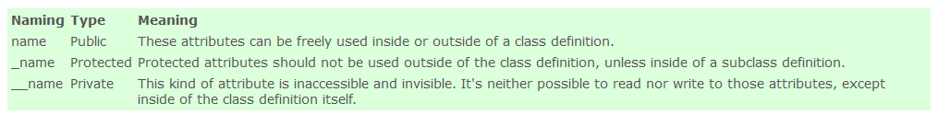
Encapsulation
In an object oriented python program, you can restrict access to methods and variables. This can prevent the data from being modified by accident and is known as encapsulation.
It allows programmers better control of how data flows in their programs, and it protects that data
Access Modifiers

Slide 20


Encapsulation cont….
Private variables
A private variable can only be changed within a class method and not outside of the class.
Example
class Car:
__maxspeed = 0
__name = ""
def __init__(self):
self.__maxspeed = 200
self.__name = "Supercar"
def drive(self):
print ('driving. maxspeed ' + str(self.__maxspeed))
redcar = Car()
redcar.drive()
redcar.__maxspeed = 10 # will not change variable because its private
redcar.drive()

Slide 21


Encapsulation cont….
Private methods
We create a class Car which has two methods: drive() and updateSoftware(). When a car object is created, it will call the private methods __updateSoftware().
This function cannot be called on the object directly, only from within the class.
Example
class Car:
def __init__(self):
self.__updateSoftware()
def drive(self):
print ('driving' )
def __updateSoftware(self):
print ('updating software' )
redcar = Car()
redcar.drive()

Slide 22
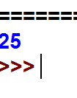
Encapsulation cont….
Protected
A variable that is protected can only be accessed by its own class and any classes derived from it.
Example
class Person:
def __init__(self, first_name, age):
self.first_name = first_name
self._age = age
def _show_age(self):
return self._age
tk = Person('TK', 25)
print(tk._show_age( ))

Slide 23
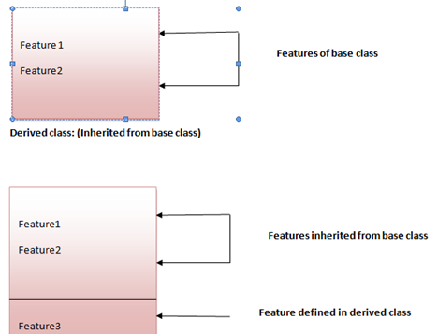
Inheritance
When one object acquires all the properties and behaviours of parent object i.e. known as inheritance.

Slide 24
Types of inheritance Single inheritance Multiple inheritance Multilevel inheritance

Slide 25
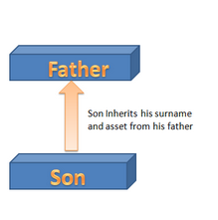

Single Inheritance
class Person:
def __init__(self, first, last):
self.firstname = first
self.lastname = last
def Name(self):
return self.firstname + " " + self.lastname
class Employee(Person):
def __init__(self, first, last, staffnum):
Person.__init__(self,first, last)
self.staffnumber = staffnum
def GetEmployee(self):
return self.Name() + ", " + self.staffnumber
x = Person("Marge", "Simpson")
y = Employee("Homer", "Simpson", "1007")
print(x.Name())
print(y.GetEmployee())
Syntax :
class BaseClass:
Body of base class
class DerivedClass(BaseClass):
Body of derived class

Slide 26
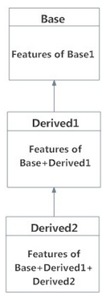
Multilevel inheritance On the other hand, we can also inherit form a derived class. This is called multilevel inheritance. It can be of any depth in Python.
Syntax:
class Base:
pass
class Derived1(Base):
pass
class Derived2(Derived1):
pass

Slide 27
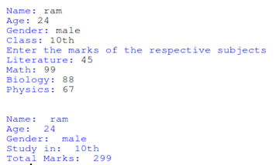
Example
class marks(test):
def display(self):
print("\n\nName: ",self.name)
print("Age: ",self.age)
print("Gender: ",self.gender)
print("Study in: ",self.stuClass)
print("Total Marks: ", self.literature + self.math + self.biology + self.physics)
m1 = marks()
m1.getStudent()
m1.getMarks()
m1.display()
class student:
def getStudent(self):
self.name = input("Name: ")
self.age = input("Age: ")
self.gender = input("Gender: ")
class test(student):
def getMarks(self):
self.stuClass = input("Class: ")
print("Enter the marks of the respective subjects")
self.literature = int(input("Literature: "))
self.math = int(input("Math: "))
self.biology = int(input("Biology: "))
self.physics = int(input("Physics: "))

Slide 28
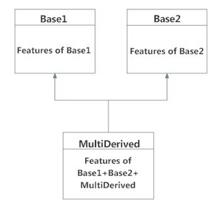
Multiple inheritance Multiple Inheritance means that you're inheriting the property of multiple classes into one.
Syntax:
class Base1:
pass
class Base2:
pass
class MultiDerived(Base1, Base2):
pass

Slide 29

Multiple inheritance cont….
class Person:
def __init__(self, personName, personAge): self.name = personName
self.age = personAge
def showName(self):
print(self.name)
def showAge(self):
print(self.age)
class Student:
def __init__(self, studentId):
self.studentId = studentId
def getId(self):
return self.studentId
class Resident(Person, Student):
def __init__(self, name, age, id): Person.__init__(self, name, age) Student.__init__(self, id) resident1 = Resident('John', 30, '102') resident1.showName() print(resident1.getId())
output

Slide 30
Why super () keyword
The super() method is most commonly used with __init__ function in base class.
In Python, super() built-in has two major use cases:
Allows us to avoid using base class explicitly
Working with Multiple Inheritance
Python super make our task easier and comfortable
Syntax
super (type[, object-or-type])

Slide 31
class Dog(NonMarineMammal, NonWingedMammal):
def __init__(self):
print('Dog has 4 legs.');
super().__init__('Dog')
d = Dog()
print('')
bat = NonMarineMammal('Bat')
Output
Dog has 4 legs.
Dog can't swim.
Dog can't fly.
Dog is a warm-blooded animal.
Dog is an animal.
Bat can't swim.
Bat is a warm-blooded animal.
Bat is an animal.
class Animal:
def __init__(self, animalName):
print(animalName, 'is an animal.');
class Mammal(Animal):
def __init__(self, mammalName):
print(mammalName, 'is a warm-blooded.')
super().__init__(mammalName)
class NonWingedMammal(Mammal):
def __init__(self, NonWingedMammalName):
print(NonWingedMammalName, "can't fly.")
class NonMarineMammal(Mammal):
def __init__(self, NonMarineMammalName):
print(NonMarineMammalName, "can't swim")
super().__init__(NonWingedMammalName)
super().__init__(NonMarineMammalName)

Slide 32
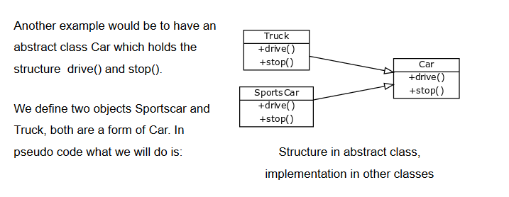
Polymorphism
Sometimes an object comes in many types or forms. If we have a button, there are many different draw outputs (round button, check button, square button, button with image) but they do share the same logic: onClick(). We access them using the same method . This idea is called Polymorphism.
The polymorphism supports for following concepts
Operator overloading
Method overloading
Method overridding

Slide 33

Method Overriding
Override means having two methods with the same name but doing different tasks. It means that one of the methods overrides the other.If there is any method in the superclass and a method with the same name in a subclass, then by executing the method, the method of the corresponding class will be executed.
class Rectangle():
def __init__(self,length,breadth):
self.length = length
self.breadth = breadth
def getArea(self):
print(self.length*self.breadth," is area of rectangle")
class Square(Rectangle):
def __init__(self,side):
self.side = side
Rectangle.__init__(self,side,side)
def getArea(self):
print(self.side*self.side*self.side," is area of square")
s=Square(4)
s.getArea()

Slide 34
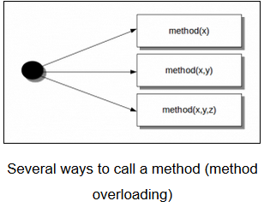
Method overloading
In Python you can define a method in such a way that there are multiple ways to call it.
Depending on the function definition, it can be called with zero, one, two or more parameters.
Example:
class Human:
def sayHello(self, name=None):
if name is not None:
print ('Hello ' + name)
else:
print('Hello ' )
obj = Human()
obj.sayHello()
obj.sayHello('Guido')
Output:
Hello
Hello Guido

Slide 35
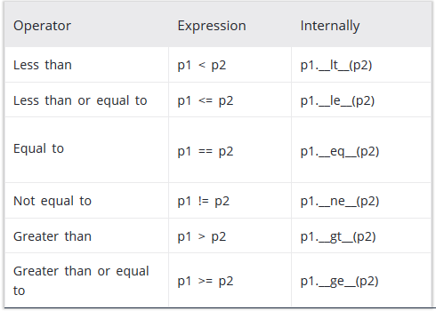
Operator Overloading
Python operator work for built-in classes. But same operator behaves differently with different types. For example, the + operator will, perform arithmetic addition on two numbers, merge two lists and concatenate two strings.
This feature in Python, that allows same operator to have different meaning according to the context is called operator overloading.
Operator Overloading Special Functions in Python

Slide 36
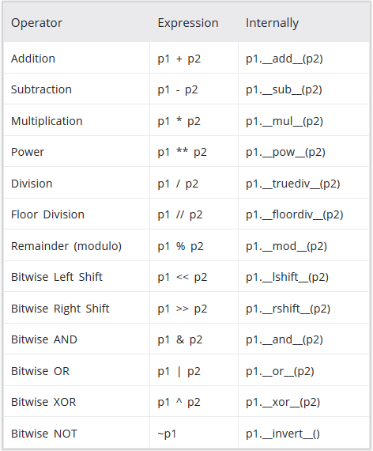
Operator Overloading cont…

Slide 37
Overloading the + Operator in Python To overload the + sign, we will need to implement __add__() function in the class.
class Point:
def __init__(self, x = 0, y = 0):
self.x = x
self.y = y
def __str__(self):
return "({0},{1})".format(self.x,self.y)
def __add__(self,other):
x = self.x + other.x
y = self.y + other.y
return Point(x,y)
p1 = Point(2,3)
p2 = Point(-1,2)
print(p1 + p2)
Output
(1,5)
when user do p1 + p2, Python will call p1.__add__(p2) which in turn is Point.__add__(p1,p2).
Similarly, user can overload other operators as well using the special functions.

Slide 38
Object Serialization with Pickle
Objects can be serialized: stored in a format for later use. Once an object is serialized, it can be stored in a file and loaded from a file. The pickle module can be used for object serialization.
Create and dump an object
We start by creating a class and object. Then we use the module dumps() with as parameter the object.
import pickle class A: def __init__(self): self.name = 'A' self.type = 'class' obj = A() dump = pickle.dumps(obj) print(dump)

Slide 39
Store and load object from file More practical is to store the serialized object in file. Then we can reload it from that file at any time. To store a serialized object into a file:
import pickle
class A:
def __init__(self):
self.name = 'A'
self.type = 'class'
obj = A()
print(obj.name)
print(obj.type)
bin_file = open('dump.bin',mode='wb')
dump = pickle.dump(obj, bin_file)
bin_file.close()
Then the object can be loaded from the file. This can be done at any time or even from another program.
import pickle
class A:
def __init__(self):
self.name = 'A'
self.type = 'class'
with open('dump.bin') as f:
obj = pickle.load(f)
print(obj.name)
print(obj.type)

Slide 40
Abstract Base Classes
Abstract classes are classes that contain one or more abstract methods. An abstract method is a method that is declared, but contains no implementation.
Abstract classes may not be instantiated, and require subclasses to provide implementations for the abstract methods.
Subclasses of an abstract class in Python are not required to implement abstract methods of the parent class.
Let's look at the following example:
class AbstractClass:
def do_something(self):
pass
class B(AbstractClass):
pass
a = AbstractClass()
b = B()
If we start this program, we see that this is not an abstract class, because:
we can instantiate an instance from
we are not required to implement do_something in the class defintition of B

Slide 41
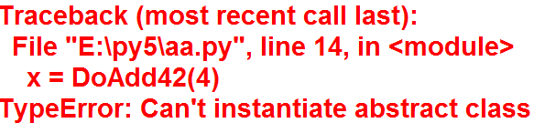
Abstract Base Classes cont….
Python comes with a module which provides the infrastructure for defining Abstract Base Classes (ABCs). This module is called - for obvious reasons - abc.
The following Python code uses the abc module and defines an abstract base class:
from abc import ABC, abstractmethod class
AbstractClassExample(ABC):
def __init__(self, value):
self.value = value
super().__init__()
@abstractmethod
def do_something(self):
pass
class DoAdd42(AbstractClassExample):
Pass
x = DoAdd42(4)

Slide 42
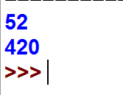
Abstract Base Classes cont….
class DoAdd42(AbstractClassExample):
def do_something(self):
return self.value + 42
class DoMul42(AbstractClassExample):
def do_something(self):
return self.value * 42
x = DoAdd42(10)
y = DoMul42(10)
print(x.do_something())
print(y.do_something())
A class that is derived from an abstract class cannot be instantiated unless all of its abstract methods are overridden.

Slide 43

Abstract Base Classes cont….
An abstract method can have an implementation in the abstract class! Even if they are implemented, designers of subclasses will be forced to override the implementation. Like in other cases of "normal" inheritance, the abstract method can be invoked with super() call mechanism. This makes it possible to provide some basic functionality in the abstract method, which can be enriched by the subclass implementation.
from abc import ABC, abstractmethod
class AbstractClassExample(ABC):
@abstractmethod
def do_something(self):
print("Some implementation!")
class AnotherSubclass(AbstractClassExample):
def do_something(self):
super().do_something()
print("The enrichment from AnotherSubclass")
x = AnotherSubclass()
x.do_something()

Slide 44
Association
Association is relation between two separate classes which establishes through their Objects.
It represents a relationship between two or more objects where the objects have their own lifecycle
Types:
1.Aggregation -If the link between two objects is weaker, and neither object has exclusive ownership of the other, it can also be called aggregation.
2.Composition -Composition is a way of aggregating objects together by making some objects attributes of other objects.

Slide 45
Example
class Learner:
def __init__(self):
self.classes = [] #list
def enrol(self, course):
self.classes.append(course) #appending course to list
class Teacher: #another class
def __init__(self, name):
self.name = name
self.courses_taught = ["C", "C++", "Java"]
def assign_teaching(self, course): # two parameter /can add new course in list
self.courses_taught.append(course)
print( self.courses_taught )
class Person:
def __init__(self, name, surname, number, learner=None, teacher=None):#learner and teacher is object
self.name = name
self.surname = surname
self.number = number
# Here the Person class Has-A learner and teacher as attributes
self.learner = learner # if i declare a object as attribute in another calss its strong association
self.teacher = teacher
def __str__(self):
return "name:{},\nno:{},\nlearner class{},\nteacher name{}".format(self.name,self.number,self.learner.classes,self.teacher.name)

Slide 46
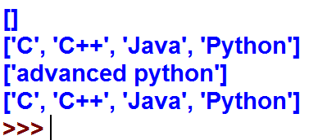
myobj = Person("Raj", "Kumar", "SMTJNX045", Learner(), Teacher("John")) #person class strongly depends on learner and teacher class
print(myobj.learner.classes)
myobj.teacher.assign_teaching("Python")
#print(myobj)
myobj.learner.enrol("advanced python")
print(myobj.learner.classes)
print(myobj.teacher.courses_taught)
Output :

